Slide 1
Public-Key Cryptography
In Symmetric key crypto only one secret key between sender and receiver is used to encrypt/decrypt.
In Symmetric key crypto maintaining the secret key between two parties is a challenge.
The main use of Symmetric key crypto is encryption and decryption
Public key crypto was invented by Whitfield Diffie & Martin Hellman at Stanford University in 1976.
Two keys, (i) private and (ii) public, so called as asymmetric key crypto.
Notes:
Will now discuss the radically different public key systems, in which two keys are used. The development of public-key cryptography is the greatest and perhaps the only true revolution in the entire history of cryptography. It is asymmetric, involving the use of two separate keys, in contrast to symmetric encryption,which uses only one key. Anyone knowing the public key can encrypt messages or verify signatures, but cannot decrypt messages or create signatures, counter-intuitive though this may seem. It works by the clever use of number theory problems that are easy one way but hard the other. Note that public key schemes are neither more nor less secure than private key (security depends on the key size for both), nor do they replace private key schemes (they are too slow to do so), rather they complement them. Both also have issues with key distribution, requiring the use of some suitable protocol.

Slide 2
Public Key Cryptography
The main idea of public key crypto is not a substitute, but a complement to symmetric key crypto.
The uses of public key crypto can be classified into 3 categories:
encryption/decryption (provide secrecy)
digital signatures (provide authentication)
key exchange (session keys)
Notes:
The concept of public-key cryptography evolved from an attempt to attack two of the most difficult problems associated with symmetric encryption: key distribution and digital signatures. The idea of public key schemes, and the first practical scheme, which was for key distribution only, was published in 1977 by Diffie & Hellman. The concept had been previously described in a classified report in 1970 by James Ellis (UK CESG) - and subsequently declassified [ELLI99]. Its interesting to note that they discovered RSA first, then Diffie-Hellman, opposite to the order of public discovery! There is also a claim that the NSA knew of the concept in the mid-60’s [SIMM93].

Slide 3
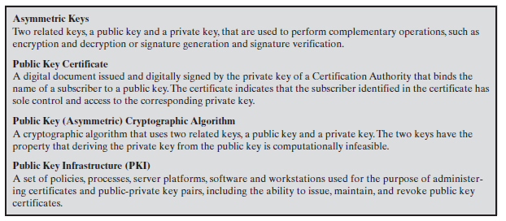
Public Key Cryptography
Notes:
The concept of public-key cryptography evolved from an attempt to attack two of the most difficult problems associated with symmetric encryption: key distribution and digital signatures. The idea of public key schemes, and the first practical scheme, which was for key distribution only, was published in 1977 by Diffie & Hellman. The concept had been previously described in a classified report in 1970 by James Ellis (UK CESG) - and subsequently declassified [ELLI99]. Its interesting to note that they discovered RSA first, then Diffie-Hellman, opposite to the order of public discovery! There is also a claim that the NSA knew of the concept in the mid-60’s [SIMM93].

Slide 4
Public Key Cryptography
Asymmetric algorithms rely on one key for encryption and a different but related key for decryption. These algorithms have the following important characteristic.
It is computationally infeasible to determine the decryption key given only knowledge of the cryptographic algorithm and the encryption key.
In addition, some algorithms, such as RSA, also exhibit the following characteristic.
Either of the two related keys can be used for encryption, with the other used for decryption.
A public-key encryption scheme has six ingredients.

Slide 5
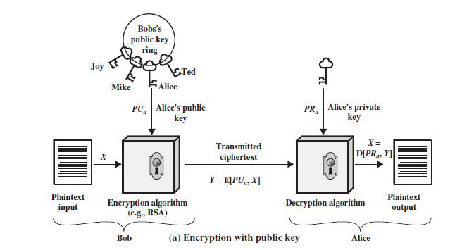
Public-Key Cryptography: Encryption with Public Key (for secrecy)
Notes:
Stallings Figure 9.1a “Public-Key Cryptography”, shows that a public-key encryption scheme has six ingredients: plaintext, encryption algorithm, public & private keys, ciphertext & decryption algorithm.
Consider the following analogy using padlocked boxes: traditional schemes involve the sender putting a message in a box and locking it, sending that to the receiver, and somehow securely also sending them the key to unlock the box. The radical advance in public key schemes was to turn this around, the receiver sends an unlocked box (their public key) to the sender, who puts the message in the box and locks it (easy - and having locked it cannot get at the message), and sends the locked box to the receiver who can unlock it (also easy), having the (private) key. An attacker would have to pick the lock on the box (hard).

Slide 6
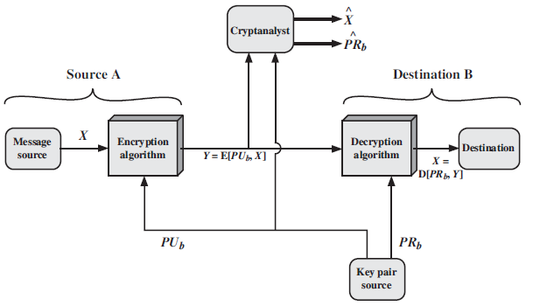
Public-Key Cryptosystems for Secrecy
Notes:
Stallings Figure 9.4 “Public-Key Cryptosystems: Secrecy and Authentication” illustrates the essential elements of a public-key encryption scheme.
Note that public-key schemes can be used for either secrecy or authentication, or both (as shown here).
In this case, separate key pairs are used for each of these purposes. The receiver owns and creates secrecy keys, sender owns and creates authentication keys.
In practice typically DO NOT do this, because of the computational cost of public-key schemes. Rather encrypt a session key which is then used with a block cipher to encrypt the actual message, and separately sign a hash of the message as a digital signature - this will be discussed more later.

Slide 7
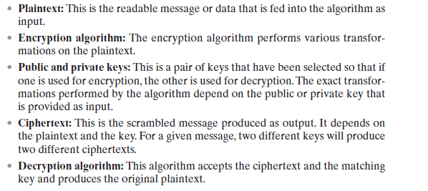
Public-Key Cryptosystems for Secrecy
Notes:
Stallings Figure 9.4 “Public-Key Cryptosystems: Secrecy and Authentication” illustrates the essential elements of a public-key encryption scheme.
Note that public-key schemes can be used for either secrecy or authentication, or both (as shown here).
In this case, separate key pairs are used for each of these purposes. The receiver owns and creates secrecy keys, sender owns and creates authentication keys.
In practice typically DO NOT do this, because of the computational cost of public-key schemes. Rather encrypt a session key which is then used with a block cipher to encrypt the actual message, and separately sign a hash of the message as a digital signature - this will be discussed more later.

Slide 8
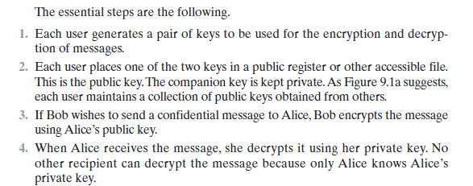
Public-Key Cryptosystems for Secrecy
Notes:
Stallings Figure 9.4 “Public-Key Cryptosystems: Secrecy and Authentication” illustrates the essential elements of a public-key encryption scheme.
Note that public-key schemes can be used for either secrecy or authentication, or both (as shown here).
In this case, separate key pairs are used for each of these purposes. The receiver owns and creates secrecy keys, sender owns and creates authentication keys.
In practice typically DO NOT do this, because of the computational cost of public-key schemes. Rather encrypt a session key which is then used with a block cipher to encrypt the actual message, and separately sign a hash of the message as a digital signature - this will be discussed more later.

Slide 9
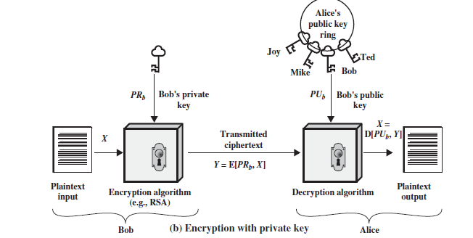
Public-Key Cryptography: Encryption with Private Key for Authentication
Notes:
Stallings Figure 9.1a “Public-Key Cryptography”, shows that a public-key encryption scheme has six ingredients: plaintext, encryption algorithm, public & private keys, ciphertext & decryption algorithm.
Consider the following analogy using padlocked boxes: traditional schemes involve the sender putting a message in a box and locking it, sending that to the receiver, and somehow securely also sending them the key to unlock the box. The radical advance in public key schemes was to turn this around, the receiver sends an unlocked box (their public key) to the sender, who puts the message in the box and locks it (easy - and having locked it cannot get at the message), and sends the locked box to the receiver who can unlock it (also easy), having the (private) key. An attacker would have to pick the lock on the box (hard).

Slide 10
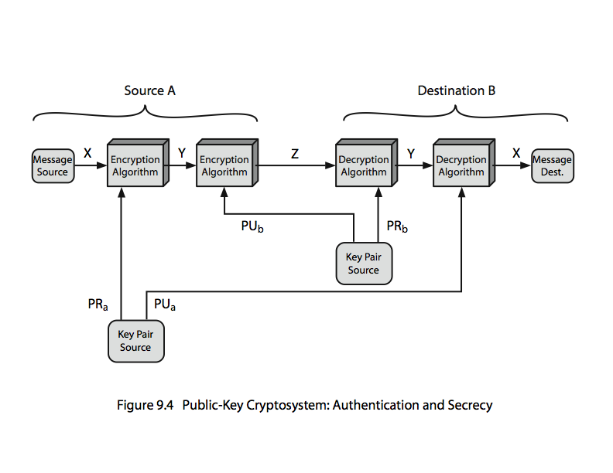
Public-Key Cryptosystems for Authentication & Secrecy
Notes:
Stallings Figure 9.4 “Public-Key Cryptosystems: Secrecy and Authentication” illustrates the essential elements of a public-key encryption scheme.
Note that public-key schemes can be used for either secrecy or authentication, or both (as shown here).
In this case, separate key pairs are used for each of these purposes. The receiver owns and creates secrecy keys, sender owns and creates authentication keys.
In practice typically DO NOT do this, because of the computational cost of public-key schemes. Rather encrypt a session key which is then used with a block cipher to encrypt the actual message, and separately sign a hash of the message as a digital signature - this will be discussed more later.

Slide 11
Public-Key Characteristics
Public-Key algorithms rely on two keys
it is computationally infeasible to find decryption key knowing only algorithm & encryption key
it is computationally easy to en/decrypt messages when the relevant (en/decrypt) key is known
either of the two related keys can be used for encryption, with the other used for decryption
Notes:
Asymmetric algorithms rely on one key for encryption and a different but related key for decryption. These algorithms have the following important characteristic: that it is computationally infeasible to determine the decryption key given only knowledge of the cryptographic algorithm and the encryption key. That is public key schemes utilise problems that are easy (P type) one way but hard (NP type) the other way, eg exponentiation vs logs, multiplication vs factoring. In addition, some algorithms, such as RSA, are also able to use either key as public & other private.

Slide 12
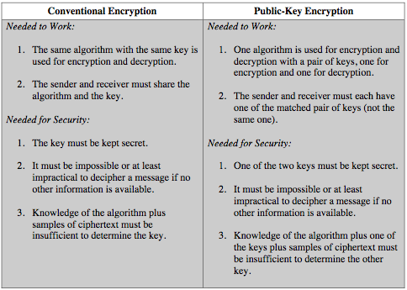
Difference b/w Conventional &Public-Key Cryptography
Notes:
Stallings Figure 9.4 “Public-Key Cryptosystems: Secrecy and Authentication” illustrates the essential elements of a public-key encryption scheme.
Note that public-key schemes can be used for either secrecy or authentication, or both (as shown here).
In this case, separate key pairs are used for each of these purposes. The receiver owns and creates secrecy keys, sender owns and creates authentication keys.
In practice typically DO NOT do this, because of the computational cost of public-key schemes. Rather encrypt a session key which is then used with a block cipher to encrypt the actual message, and separately sign a hash of the message as a digital signature - this will be discussed more later.

Slide 13
Public-Key Requirements
Need a trapdoor one-way function
one-way function has
Y = f(X) easy
X = f^{–1}(Y) infeasible
a trap-door one-way function has
Y = f_{k}(X) easy, if k and X are known
X = f_{k}^{–1}(Y) easy, if k and Y are known
X = f_{k}^{–1}(Y) infeasible, if Y is known but k not known
a practical public-key scheme depends on a suitable trap-door one-way function

Slide 14
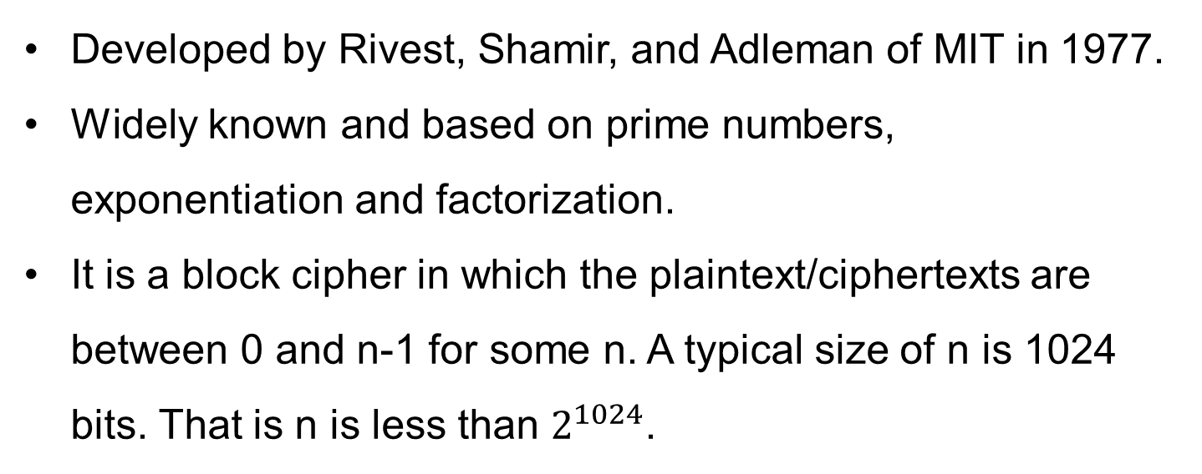
RSA

Slide 15
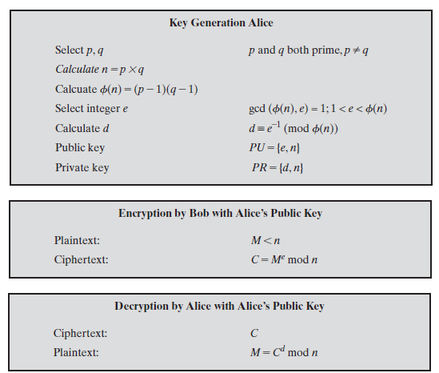
RSA Algorithm
Notes:
RSA key setup is done once (rarely) when a user establishes (or replaces) their public key, using the steps as shown. The exponent e is usually fairly small, just must be relatively prime to ø(n). Need to compute its inverse mod ø(n) to find d. It is critically important that the factors p & q of the modulus n are kept secret, since if they become known, the system can be broken. Note that different users will have different moduli n.

Slide 16
Example
Select primes: p=17 & q=11
Calculate n = pq =17 x 11=187
Calculate ø(n)=(p–1)(q-1)=16x10=160
Select e: gcd(e,160)=1; choose e=7
Find d such that de=1 mod 160 and d < 160
Value of d=23 since 23×e=161
6. Publish public key PU={7,187}
7. Keep private key PR={23,187}

Slide 17
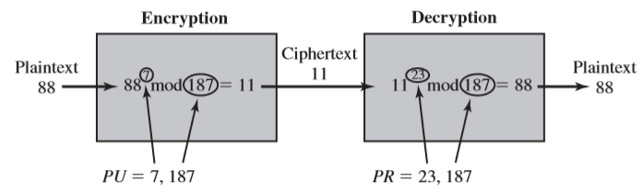
Example
given message M = 88, (88<187)
encryption: C = 88⁷ mod 187 = 11
decryption: M = 11²³ mod 187 = 88

Slide 18
Exponentiation in Modular Arithmetic
a fast, efficient algorithm for exponentiation is repeatedly dividing the exponent to lower powers and multiplying
The following property of mod can also be used.

Slide 19
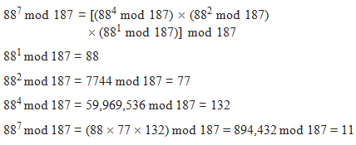
Exponentiation

Slide 20
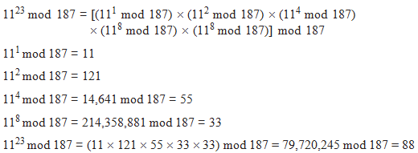
Exponentiation

Slide 21
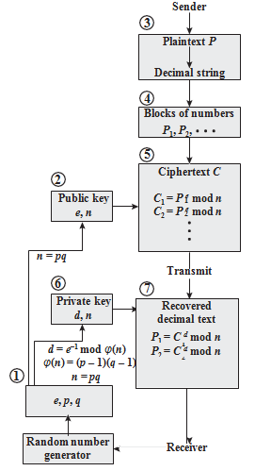
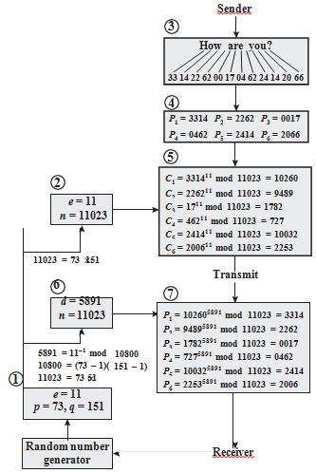
RSA Processeing of Multiple Blocks

Slide 22
Attacks on RSA
Four Possible Approaches to attack RSA
Bruteforce attack: Typing of all possible keys.
Defence-large key space. ‘d’ large number of bits.(p and q Large values may cause to d large value)
Mathematical Attacks: Factoring the product of two primes.
A) Factoring n into two prime factors which may lead to know phi(n) and d
B) Determine phi(n) directly without determining p and q
C)Determine d directly without determining phi(n).
To specify the size of n(to avoid factorization) :
P and q should differ in length by only few digits
Both (p-1) and (q-1) should contain a large prime factors.
gcd(p-1,q-1) should be small
Timing Attacks: running time of the decryption algorithm.
Chosen Cipher text attack: Type of attack exploits properties of the RSA algorithm.
Notes:
Note some possible possible approaches to attacking the RSA algorithm, as shown.
The defense against the brute-force approach is the same for RSA as for other cryptosystems, namely, use a large key space. Thus the larger the number of bits in d, the better. However because the calculations involved both in key generation and in encryption/decryption are complex, the larger the size of the key, the slower the system will run.
Will now review the other possible types of attacks.

Slide 23
RSA Timing Attack
Paul Kocher demonstrated that a Snooper can determine a private key by keeping track of how long a computer takes to decipher messages(Cipher text only attack).
Suppose a target system uses a modular multiplicative function that is very fast in almost all cases but in few cases takes much more time than an entire average modular exponentiation.
Attack proceeds bit by bit starting from leftmost bit b_{k.}
Suppose that the first j bits are known(d value j Bits). Attacker can complete the first j iterations of the for loop(for given cipher text).
Operation of subsequent steps depends on the unknown exponent bit.
If the bit is set d←(d*a) mod n will be executed.
For few values of a & d, the modular multiplication will be extremely slow and the attacker knows them.
Eg: if the decryption algorithm is slow it is assumed to be 1 or it is assumed to be 0(fast )
Notes:
Note some possible possible approaches to attacking the RSA algorithm, as shown.
The defense against the brute-force approach is the same for RSA as for other cryptosystems, namely, use a large key space. Thus the larger the number of bits in d, the better. However because the calculations involved both in key generation and in encryption/decryption are complex, the larger the size of the key, the slower the system will run.
Will now review the other possible types of attacks.

Slide 24
Counter Measures of RSA timing attack
Constant Exponential Time: Same amount of time for all exponentiation.
Random Delay: Add random delay to the exponential algorithm.
Blinding: Multiply Cipher text by a random number before performing exponentiation to prevent attacker knowing what the cipher text bits are.
Blinding Features incorporated in RSA:
Generate a Secrete random number r between 0 and n-1
Compute C’=c(r^{e)} mod n where e is public
Compute M’=(C’)^{d} mod n
M=M’r⁻¹ mod n where r inverse is multiplicative inverse of r mod n
Correct result can be observed by observing r^{ed} mod n = r mod n
Notes:
We can identify three approaches to attacking RSA mathematically, as shown. Mathematicians currently believe all equivalent to factoring.
See Stallings Table 9.4 for progress in factoring, where see slow improvements over the years, with the biggest improvements coming from improved algorithms.
The best current algorithm is the “Lattice Sieve” (LS), which replaced the “Generalized Number Field Sieve” (GNFS), which replaced the “Quadratic Sieve”(QS).
Have to assume computers will continue to get faster, and that better factoring algorithms may yet be found.
Numbers of size 1024-2048 bits look reasonable at present, provided the factors meet other constraints.

Slide 25
Chosen Cipher Text Attack(CCA) and Optimal Symmetric Encryption Padding(RSA)
Takes advantage of the following Property: E(Pu,M1)*E(pu,M2)=E(Pu(M1,M2))
Can decrypt C=Me mod n using CCA as follows
Compute X=(C*2e) mod n
Submit X as a Choosen C and Receive back Y= (X^{d}) mod n
Note that X= (C mod n)* (2e mod n)
= (Me mod n)* (2e mod n)
=(2M)^{e} mod n
We can Deduce M
To Overcome this attack RSA randomly Pad the Plaintext prior to encryption.
Encrypt the Plain text using a procedure known as “Optimal Assymetric Encryption Padding(OASP).
Notes:
Stallings Table 9.5 shows the progress in factoring to date. The level of effort is measured in MIPS-years: a million-instructions-per-second processor running for one year, which is about 3 x 10¹³ instructions executed. A 1 GHz Pentium is about a 250-MIPS machine.

Slide 26
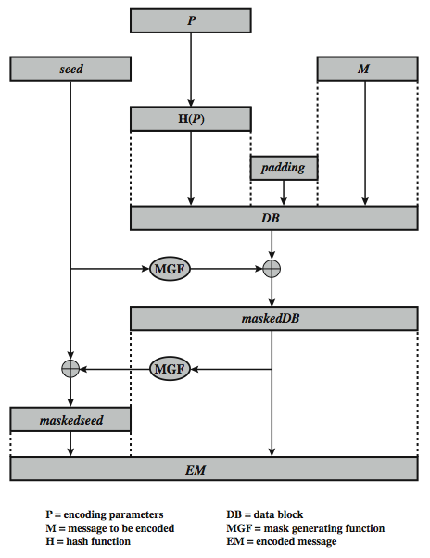
Optimal Asymmetric Encryption Padding (OASP)
Notes:
To counter such attacks RSA Security Inc., a leading RSA vendor and former holder of the RSA patent, recommends modifying the plaintext using a procedure known as optimal asymmetric encryption padding (OAEP). Stallings Figure 9.10 depicts OAEP encryption. As a first step the message M to be encrypted is padded. A set of optional parameters P is passed through a hash function H. The output is then padded with zeros to get the desired length in the overall data block (DB). Next, a random seed is generated and passed through another hash function, called the mask generating function (MGF). The resulting hash value is bit-by-bit XORed with DB to produce a maskedDB. The maskedDB is in turn passed through the MGF to form a hash that is XORed with the seed to produce the masked seed. The concatenation of the maskedseed and the maskedDB forms the encoded message EM. Note that the EM includes the padded message, masked by the seed, and the seed, masked by the maskedDB. The EM is then encrypted using RSA.

